Slide 1

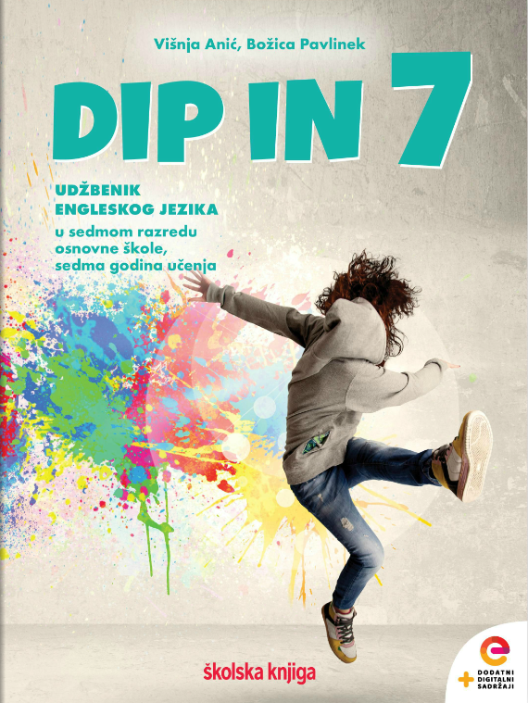
Lesson 12 To watch TV or to read a book?
UNIT 3

Slide 2
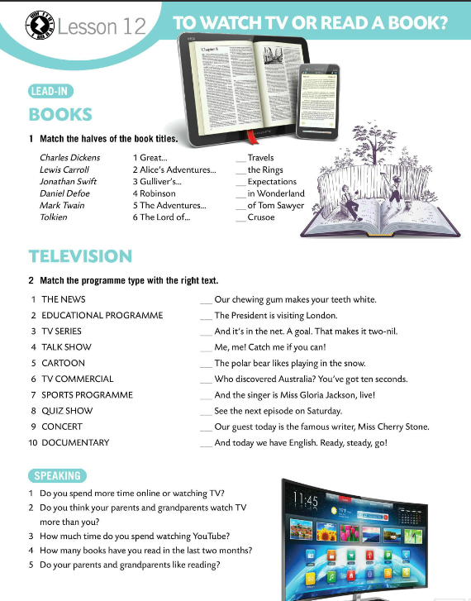
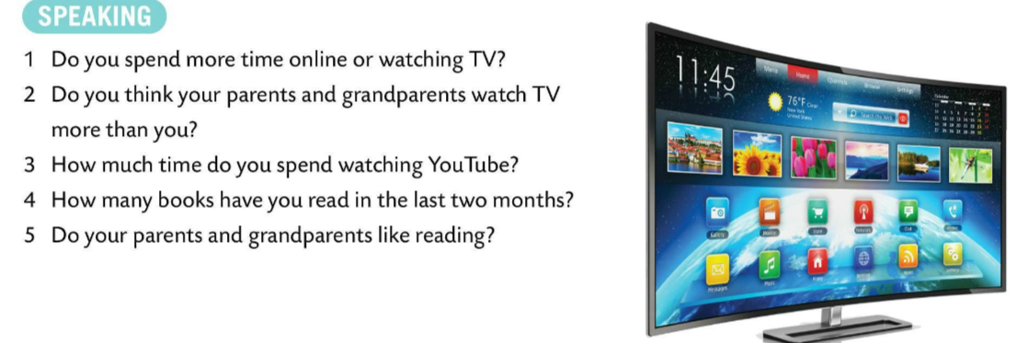
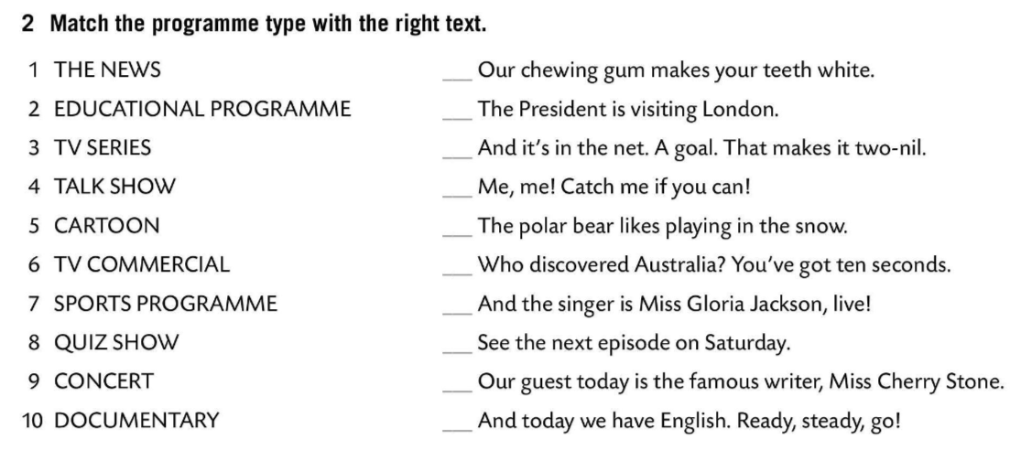
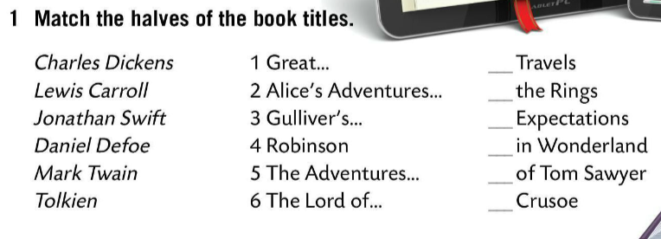
Match the halves of a book titles.
Check.
Match the programme type with the right text.
6
1
7
3
Check.
5
6
10
1
8
2
Speaking time!
Read the questions and answer them.
9
5
3
4
4
2

Slide 3
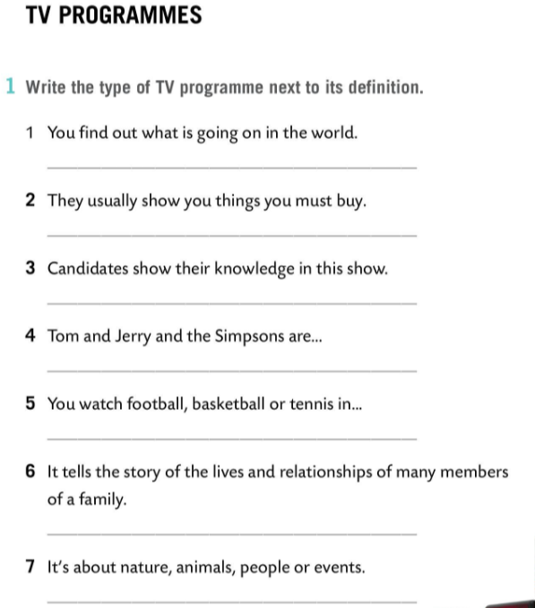
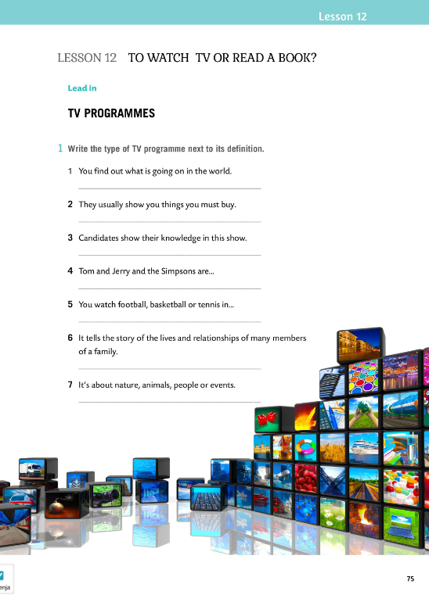
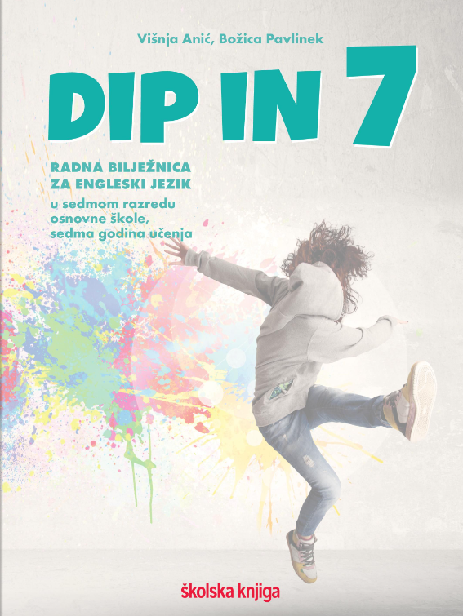
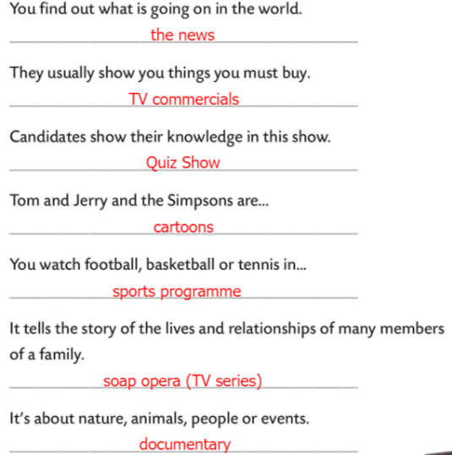
Workbook, page 75
Write the type of TV programme next to its definition.
Check.

Slide 4
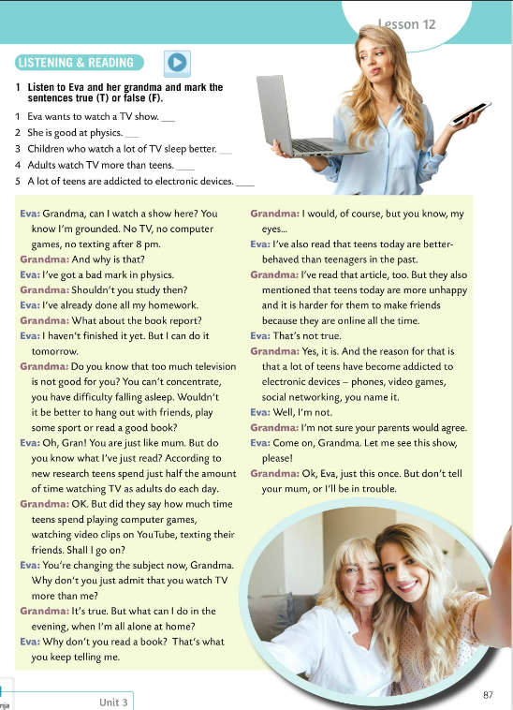
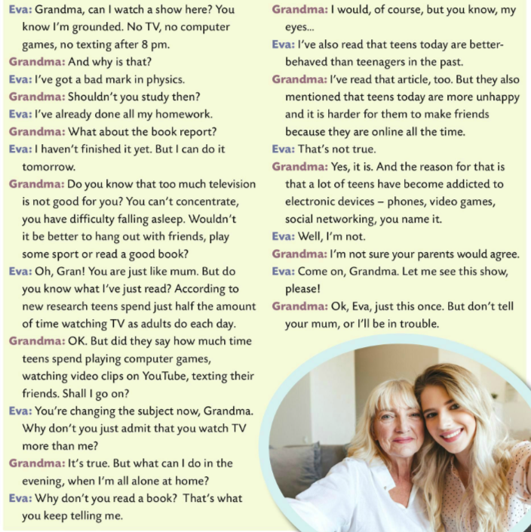

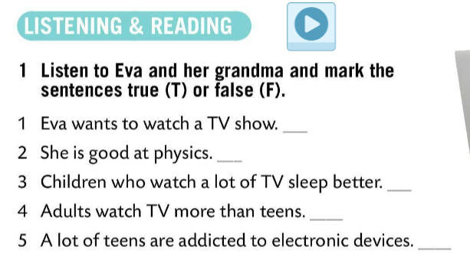
Listen to Eva and her grandma and mark the sentences true (T) or false (F).
Check.
T
Read the text and underline new words. Translate them into Croatian.
F
F
T
T
Read the text in pairs.

Slide 5
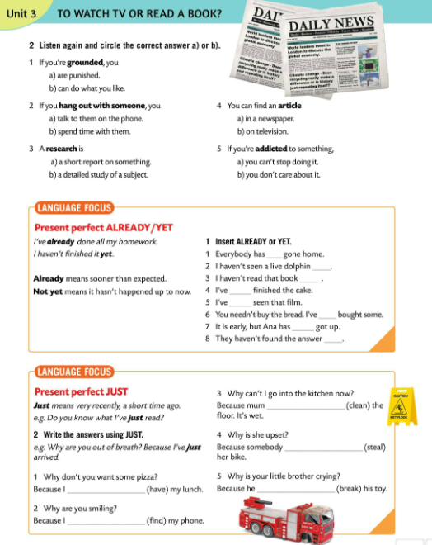
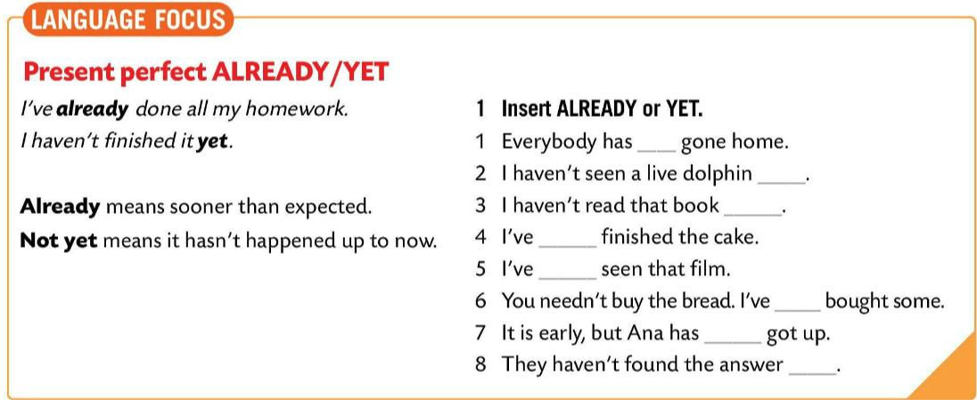
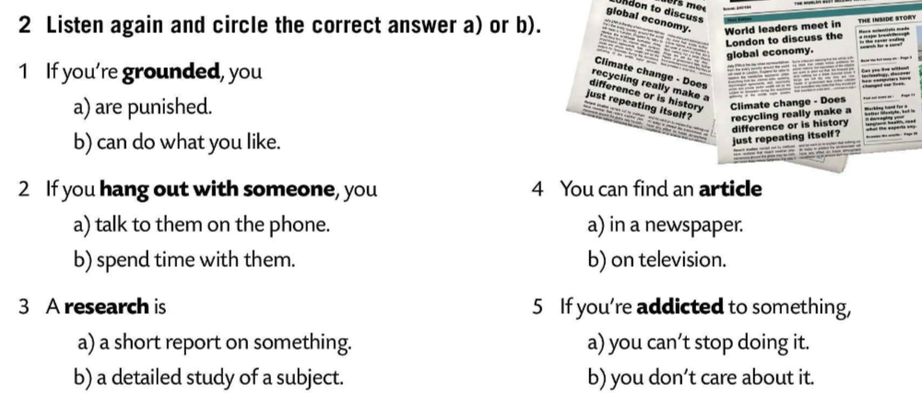
Listen to the conversation again and circle the correct answer a) or b).
Check.
LANGUAGE FOCUS
With the present perfect we often use ALREADY and YET.
Često uz present perfect koristimo izraze ALREADY (već) i NOT YET (još ne).
I’ve already done my homework.
(Već sam napisao zadaću.)
I haven’t finished it yet.
(Još ju nisam dovršio.)

Slide 6
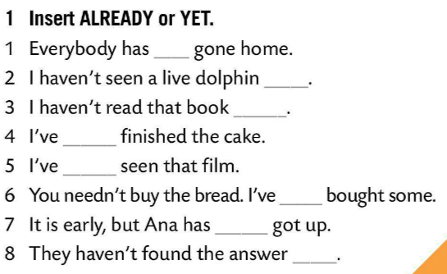
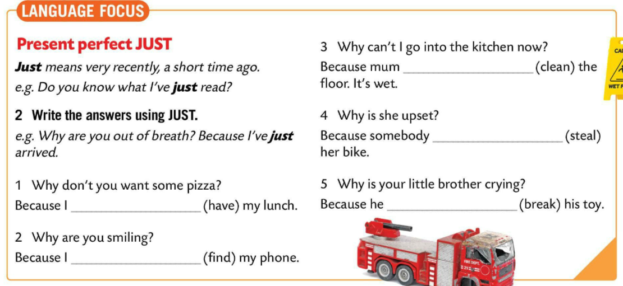
ALREADY means sooner than expected.
NOT YET means it hasn’t happened up to now.
ALREADY znači ranije od očekivanog.
NOT YET znači da se nije dogodilo još uvijek, do trenutka u kojem govorimo.
already
yet
Insert ALREADY or YET.
yet
already
Check.
already
already
already
JUST means very recently, a short time ago.
JUST znači upravo, nešto što se nedavno dogodio.
e.g. Do you know what I’ve just read?
(Znaš li što sam upravo pročitao?)
yet

Slide 7
Write the answers using JUST.
Check.
has just cleaned
Take a quiz.
https://wordwall.net/play/849/724/768
has just stolen
have just had
has just broken
have just found
Copy the rules and examples in your notebook.

Slide 8
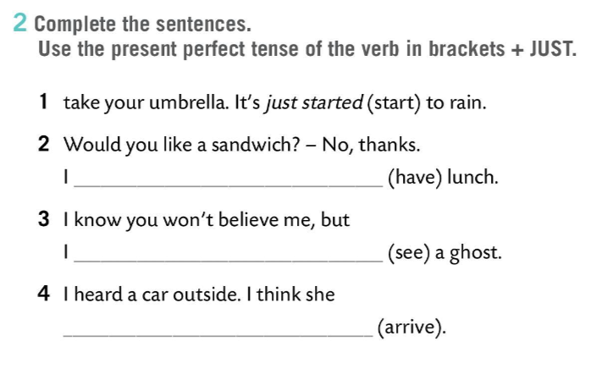
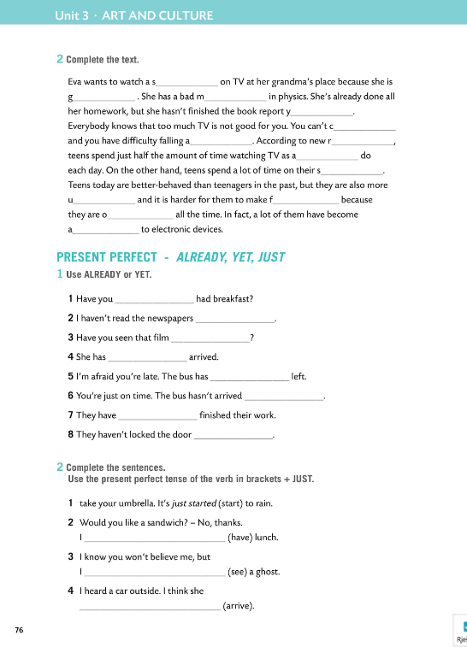
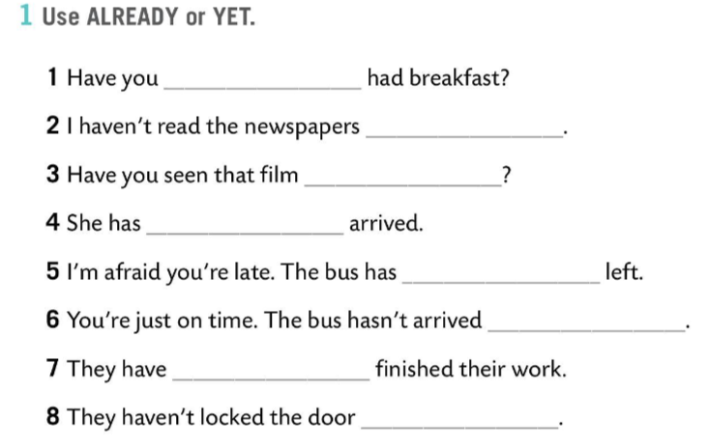
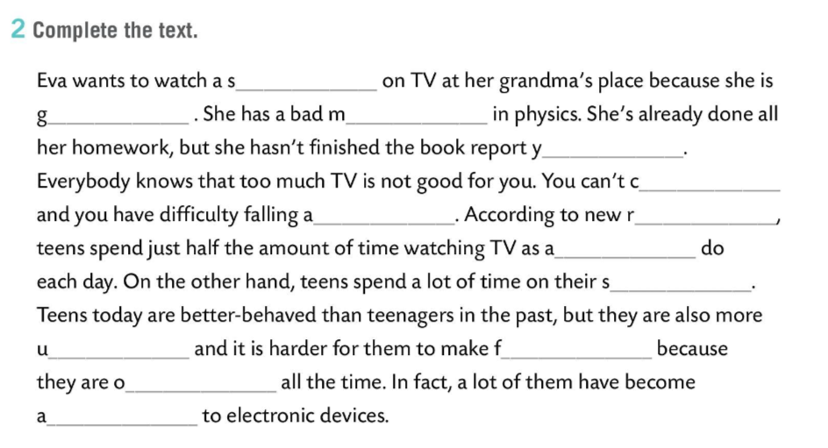
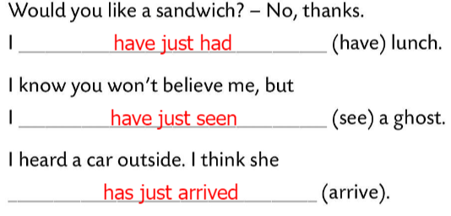
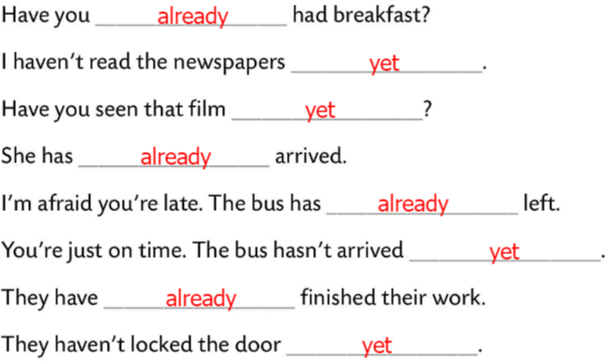
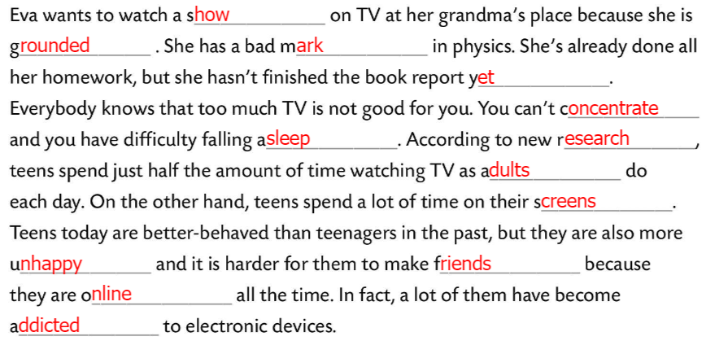
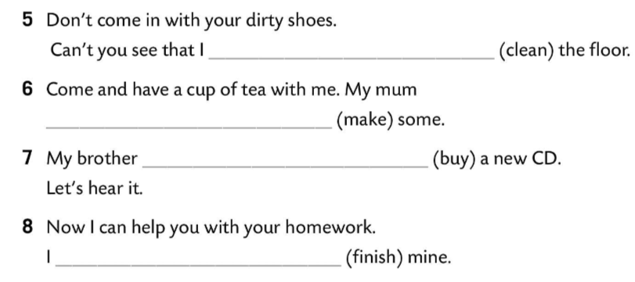
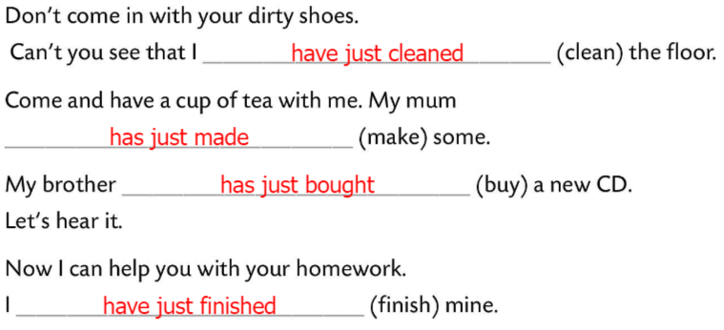
Workbook, page 76
Complete the text.
Check.
Use ALREADY or YET.
Check.
Complete the sentences. Use the present perfect tense of the verb in the brackets + JUST.
Check.

Slide 9
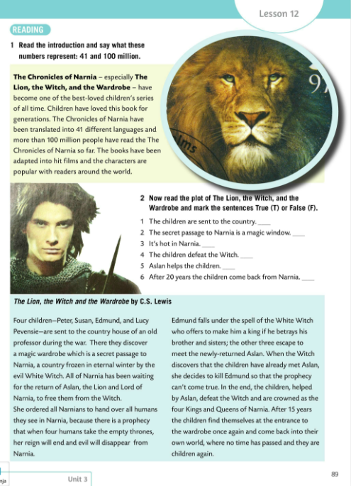
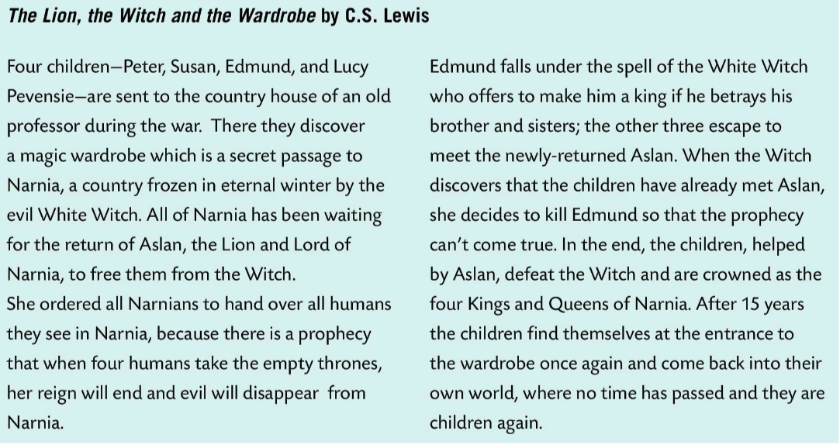
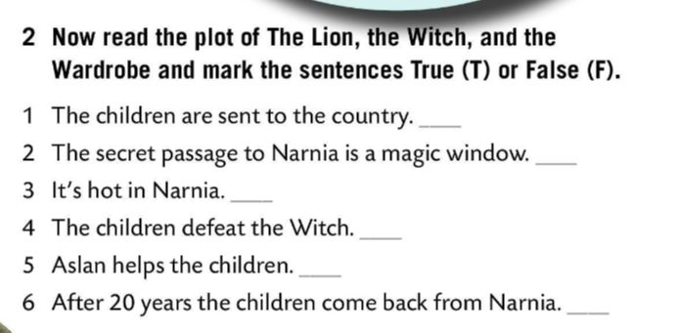
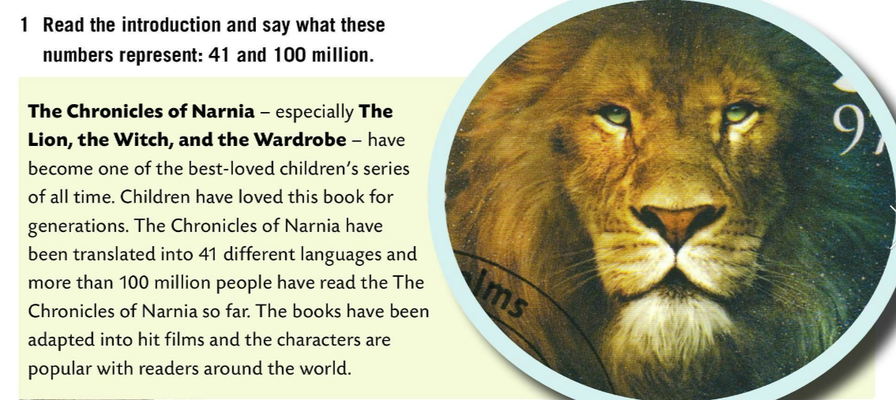
Read the introduction and say what these numbers represent: 41 and 100 million.
Check.
The Chronicles of Narnia have been translated into 41 languages and more than 100 million people have read the book so far.
T
F
F
T
T
F
Now read the plot of The Lion, the Witch, and the Wardrobe and mark the sentences True (T) or False (F).
Check.

Slide 10
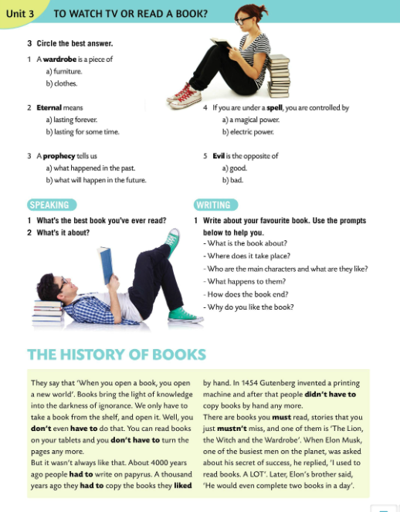
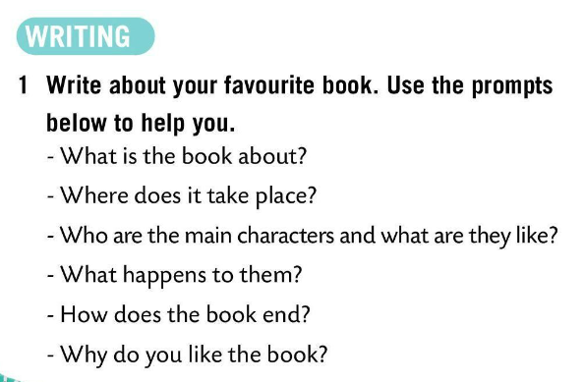
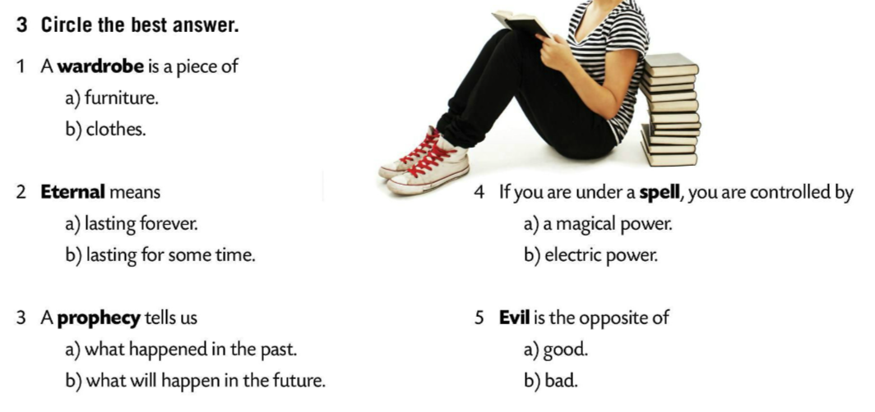
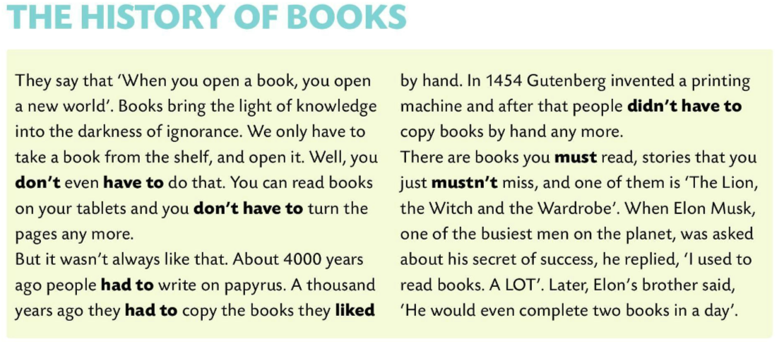
Circle the best answer.
Check.
Speaking time!
1 What’s the best book you’ve ever read?
2 What is it about?
Write about your favourite book. Use the prompts below to help you.
Read about the history of books.

Slide 11
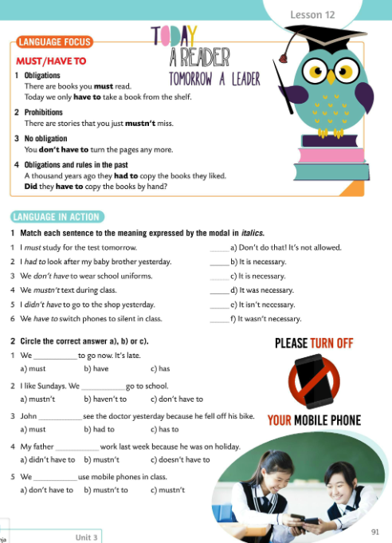
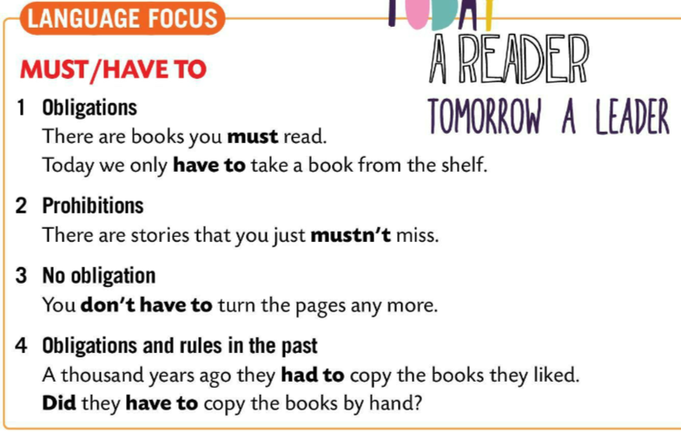
LANGUAGE FOCUS
We use both MUST and HAVE TO to express obligations.
Za izražavanje obaveza i dužnosti koristimo MUST i HAVE TO.
e.g.
There are books you MUST read.
Today we only HAVE TO take a book from the shelf.
We use MUSTN’T for prohibitions.
Za izražavanje zabrana koristimo MUSTN’T.
e.g. There are stories you MUSTN’T miss.

Slide 12
We use DON’T HAVE TO when we have an option to choose and something is not an obligation.
DON’T HAVE TO koristimo kada imamo mogućnost odabira/izbora te kada nešto nije obaveza i ne moramo to nužno učiniti.
e.g. You DON’T HAVE TO turn the pages anymore.
We use HAD TO for obligations and rules in the past.
Za izražavanje prošlih pravila i obaveza koristimo HAD TO.
e.g. A thousand years ago they HAD TO copy the book they liked.

Slide 13
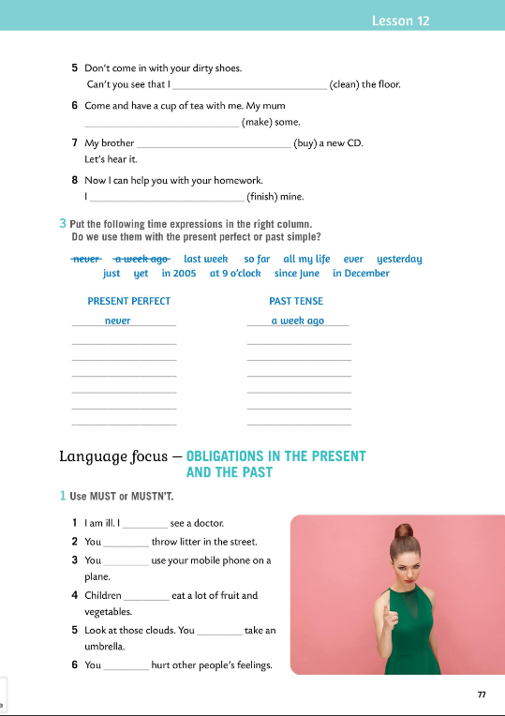
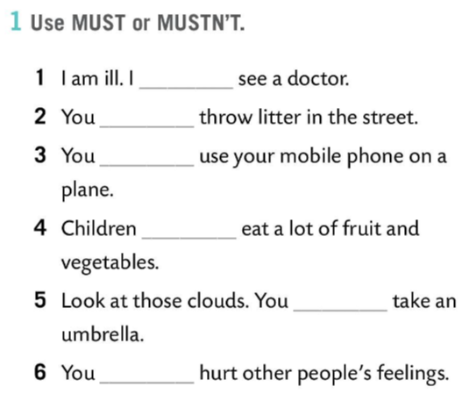
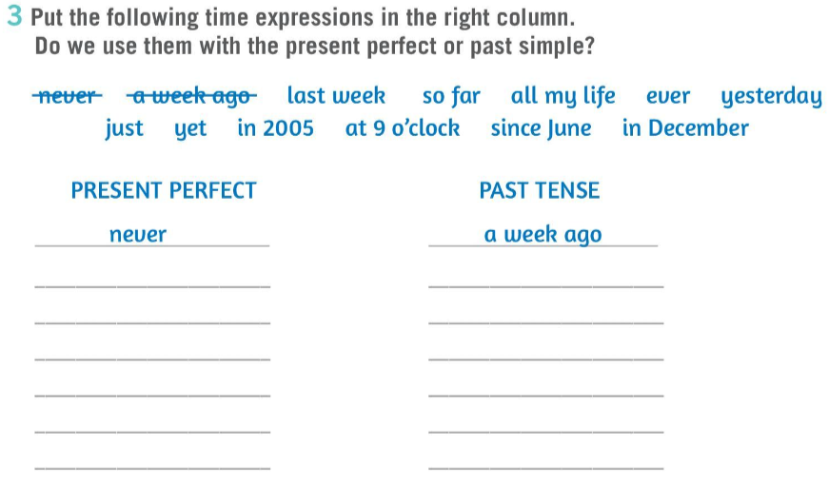
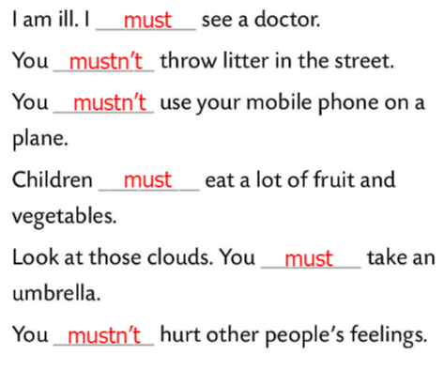
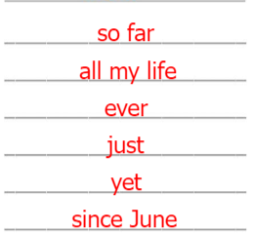
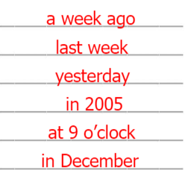
Workbook, page 77
Put the following time expressions in the right column. Do we use them with the present perfect or past simple?
Check.
Use MUST or MUSTN’T.
Check.

Slide 14
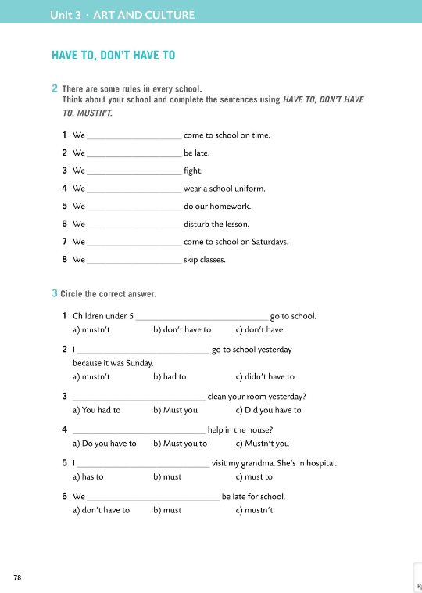
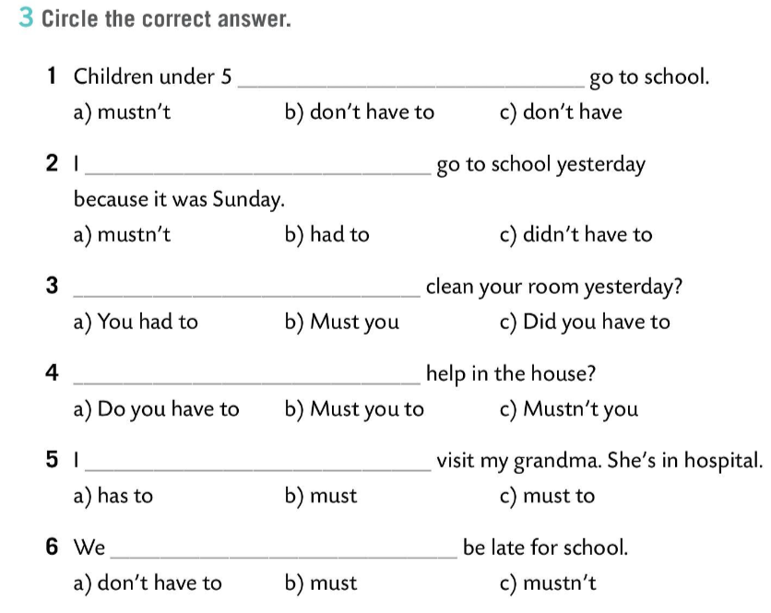
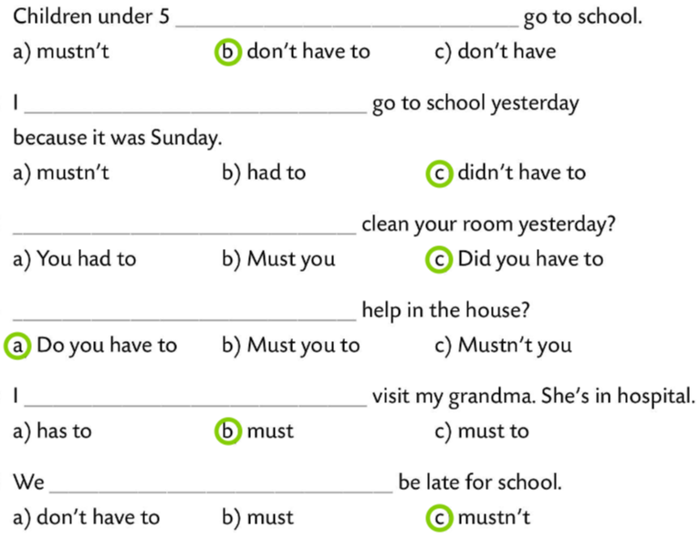
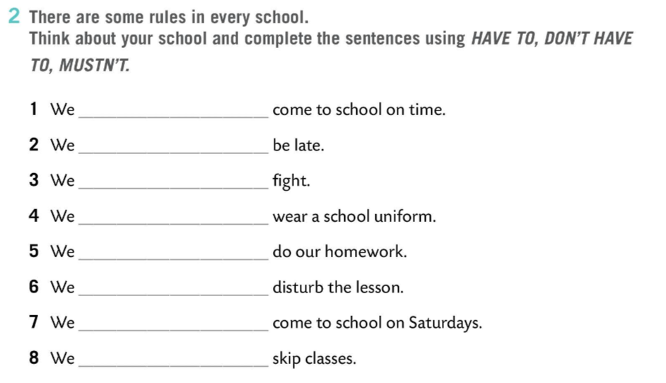
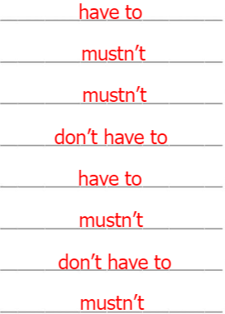
Workbook, page 78
There are some rules in every school. Think about your school and complete the sentences using HAVE TO, DON’T HAVE TO, MUSTN’T.
Check.
Circle the correct answer.
Check.

Slide 15
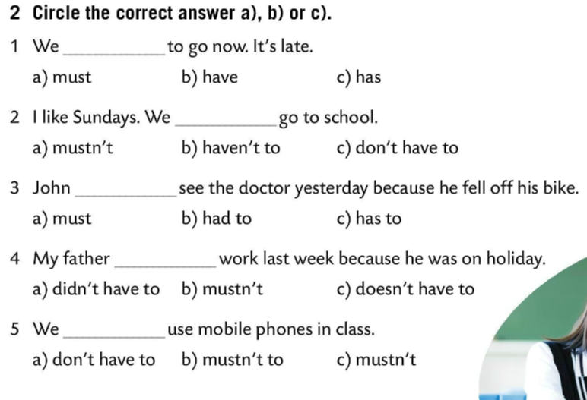
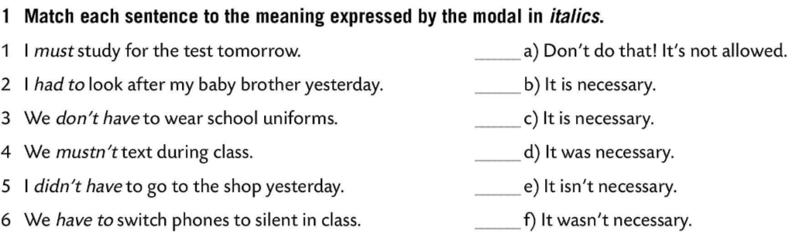

Match each sentence to the meaning expressed by the modal in italics.
Check.
Circle the correct answer a), b) or c).
Check.
Revise TV vocabulary with this wordsearch puzzle online!
https://wordwall.net/play/849/631/748

